Slide 1

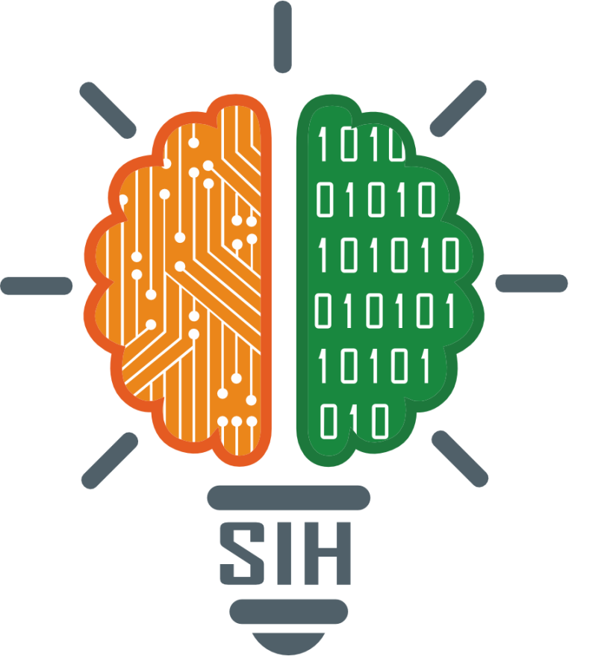
SMART INDIA HACKATHON 2024
TITLE PAGE
Problem Statement ID – SIH1598
Problem Statement Title- Student Innovation
Theme- Heritage & Culture
PS Category- Software
Team ID-
Team Name (Registered on portal)

Slide 2
IDEA TITLE
Nivaran
Proposed Solution
Idea :
Solution :
Prototype :
Promoting Hidden Heritage: Build a website dedicated to promoting India's diverse and lesser-known heritage and cultural locations.
Inclusive Platform: Focus on small towns, villages, and hidden gems, often overshadowed by more popular destinations.
Cultural Preservation: Create an inclusive platform that connects every corner of India by showcasing local food, traditions, and places.
Cultural Preservation: Digitally archive and preserve India's intangible heritage, ensuring that local customs, languages, and traditions are recorded for future generations.
Heritage Value Section: Provides detailed information about historical and cultural significance, accessible without any sponsorship.
Word of Mouth Section: Allows small businesses (e.g., local hotels, restaurants) to pay for listings and promotions, ensuring visibility for those supporting local economies.
User Interaction: Features like ratings, user reviews, and personal recommendations to increase engagement and reliability.
Affiliate Tie-Ups: Collaborate with local guides and platforms (Airbnb, etc.) to give tourists authentic experiences while boosting the local economy.
Modern, Responsive Design: Easy navigation and an immersive experience for users across all devices.
State and City Pages: Provide historical context and highlight cultural aspects of each region.
Listing Model: Implement a pay-to-list and sponsorship system for small businesses to promote their services.
Community Section (Future Plan): A space for foreign users and locals to exchange cultural knowledge, promoting India's heritage globally.

Slide 3
TECHNICAL APPROACH
Nivaran
Technologies to be used (e.g. programming languages, frameworks, hardware)
Methodology and process for implementation (Flow Charts/Images/ working prototype)

Slide 4
FEASIBILITY AND VIABILITY
Nivaran
Feasibility :
Viability :
Technical: Leveraging modern web development frameworks (React, Node.js) and cloud solutions (AWS, Azure) to ensure scalability and performance.
Content Sourcing: Collaborating with local experts, guides, and cultural institutions to gather authentic information.
User Accessibility: Designing the platform with mobile-first principles to cater to a wide audience, including rural areas with lower bandwidth.
Low Development Cost: Use of open-source tools and technologies (e.g., WordPress, Django) reduces development and maintenance expenses, making it feasible even for a lean team.
Cultural Collaborations: Partnering with local cultural organizations and tourism boards ensures a steady flow of content and reduces the burden of content creation.
Financial Model: Revenue from business listings, sponsorships, and affiliate tie-ups with local guides, accommodations, and services.
Sustainability: The growing trend of cultural tourism ensures long-term relevance. The focus on lesser-known areas fills an untapped niche.
Government Support: Potential partnerships with government bodies for heritage conservation and tourism promotion.
Tourist Engagement: Incorporating interactive features like personalized recommendations and travel itineraries keeps users engaged and encourages repeat visits, increasing platform viability.
Social Media Integration: Use social media campaigns and influencer partnerships to promote the platform, tapping into the growing trend of travel content consumption, which can drive both user traffic and business partnerships.

Slide 5
IMPACT AND BENEFITS
Nivaran
Impact :
Benefits :
Cultural Revival: Promotes lesser-known cultural and heritage sites, helping to revive interest in places often ignored by mainstream tourism.
Local Economy Boost: Encourages tourism in smaller towns and villages, providing economic support to local businesses, artisans, and service providers.
Youth Engagement: Inspires curiosity among students and young travelers to explore and understand India's rich cultural heritage, fostering a sense of pride and identity.
Cultural Exchange: Facilitates a deeper understanding and appreciation of diverse Indian traditions, fostering cultural exchange both within the country and globally.
Sustainable Tourism: Promotes responsible and sustainable tourism by encouraging visitors to explore underdeveloped areas, reducing overcrowding in popular tourist spots.
For the Government: Supports heritage conservation efforts and increases tourism revenue, aiding in the preservation of local history and culture.
For Travelers: Offers a structured and easy-to-navigate platform to discover hidden gems across India, improving their travel experience.
For Local Communities: Provides exposure and business opportunities to local vendors, guides, and accommodation providers, ensuring inclusive growth.
For Local Artisans: Provides a platform for artisans to showcase and sell traditional crafts, helping preserve cultural craftsmanship and generate income.
For Students: Acts as an educational tool for students, offering a rich database of historical and cultural content, encouraging cultural awareness and research opportunities.

Slide 6
RESEARCH AND REFERENCES
Nivaran
Details / Links of the reference and research work

